Slide 1
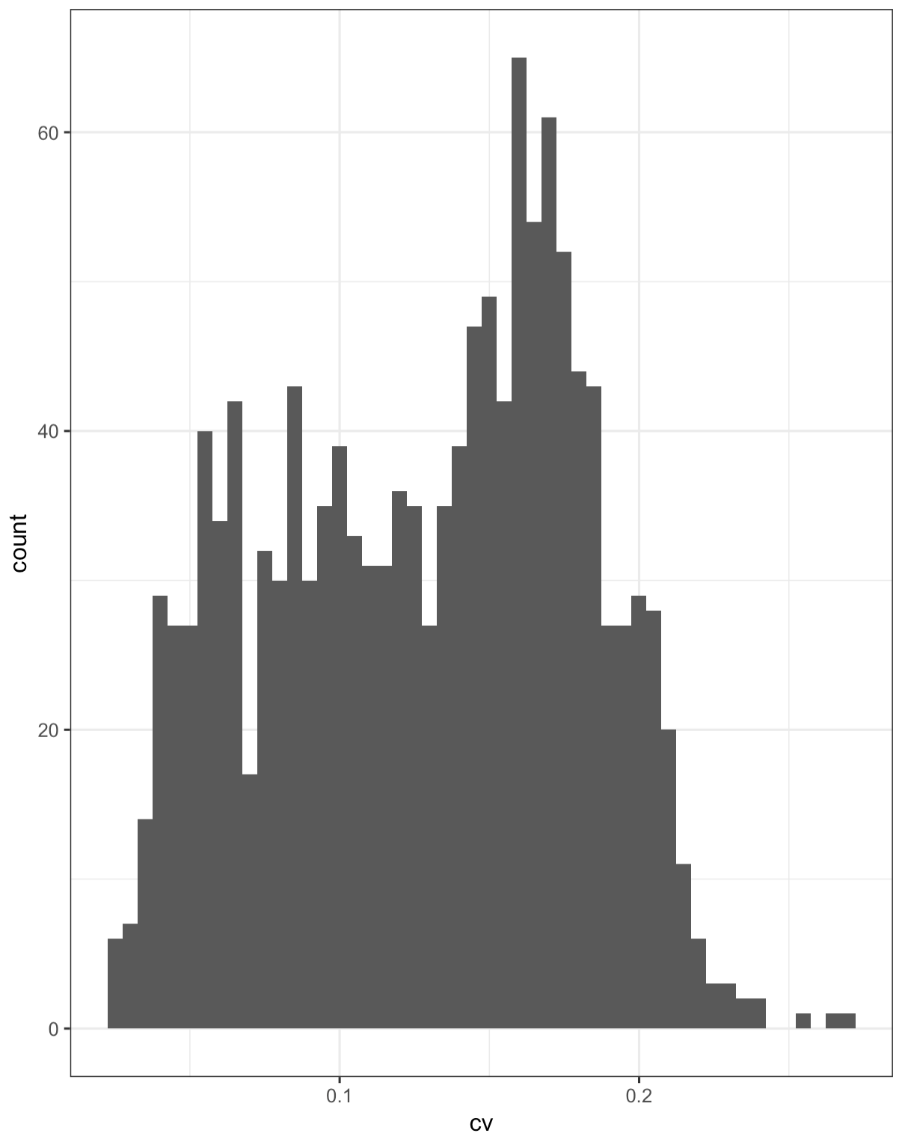

Slide 2
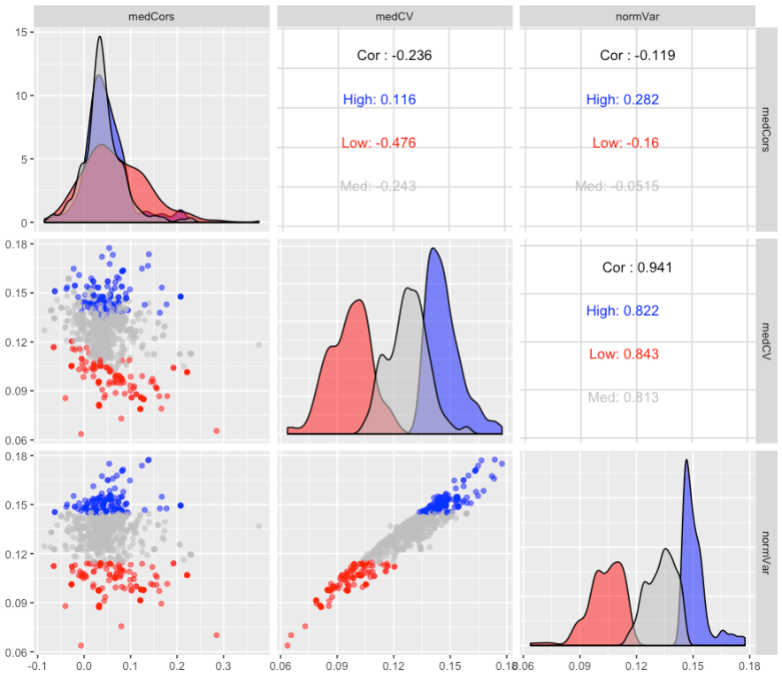
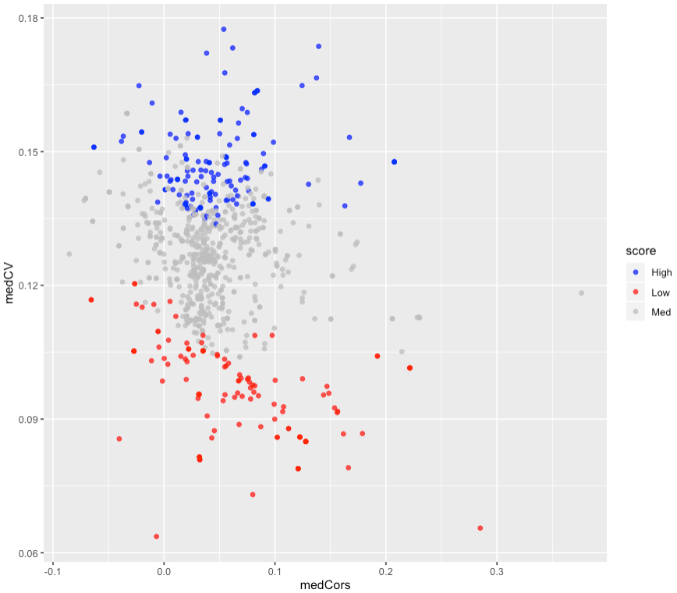
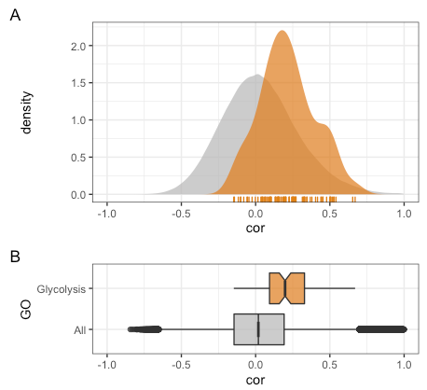

Slide 3
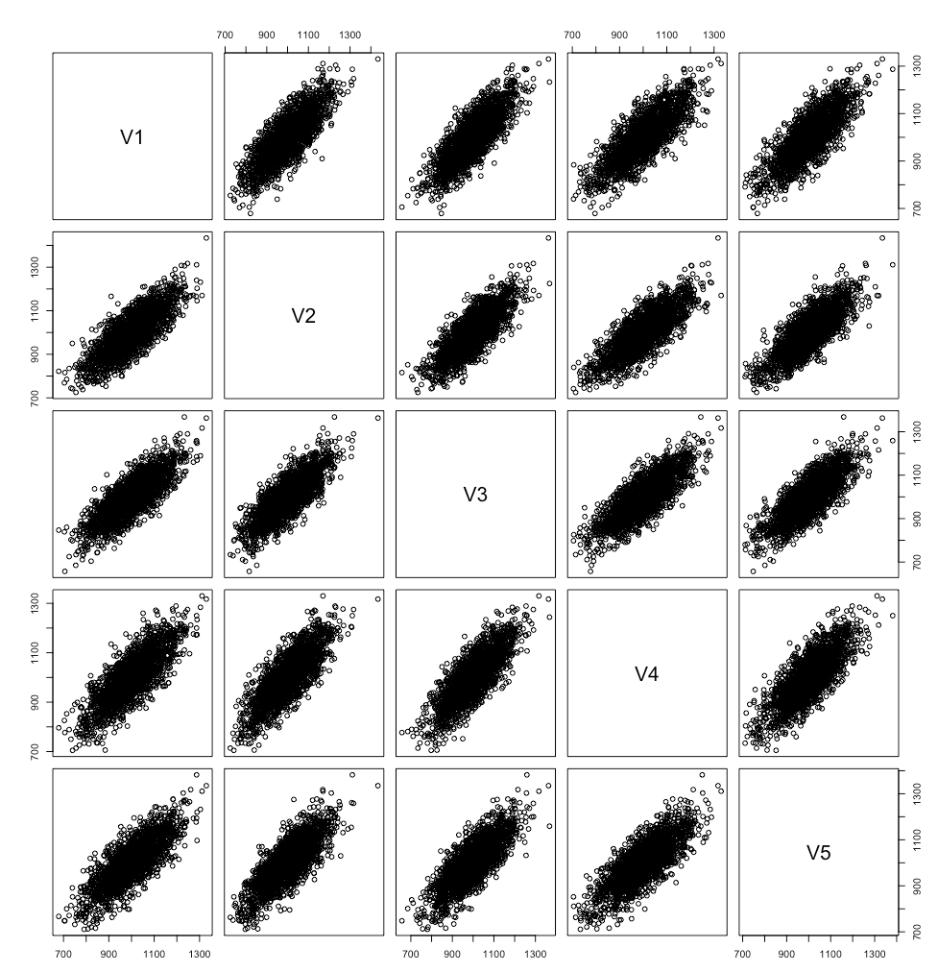
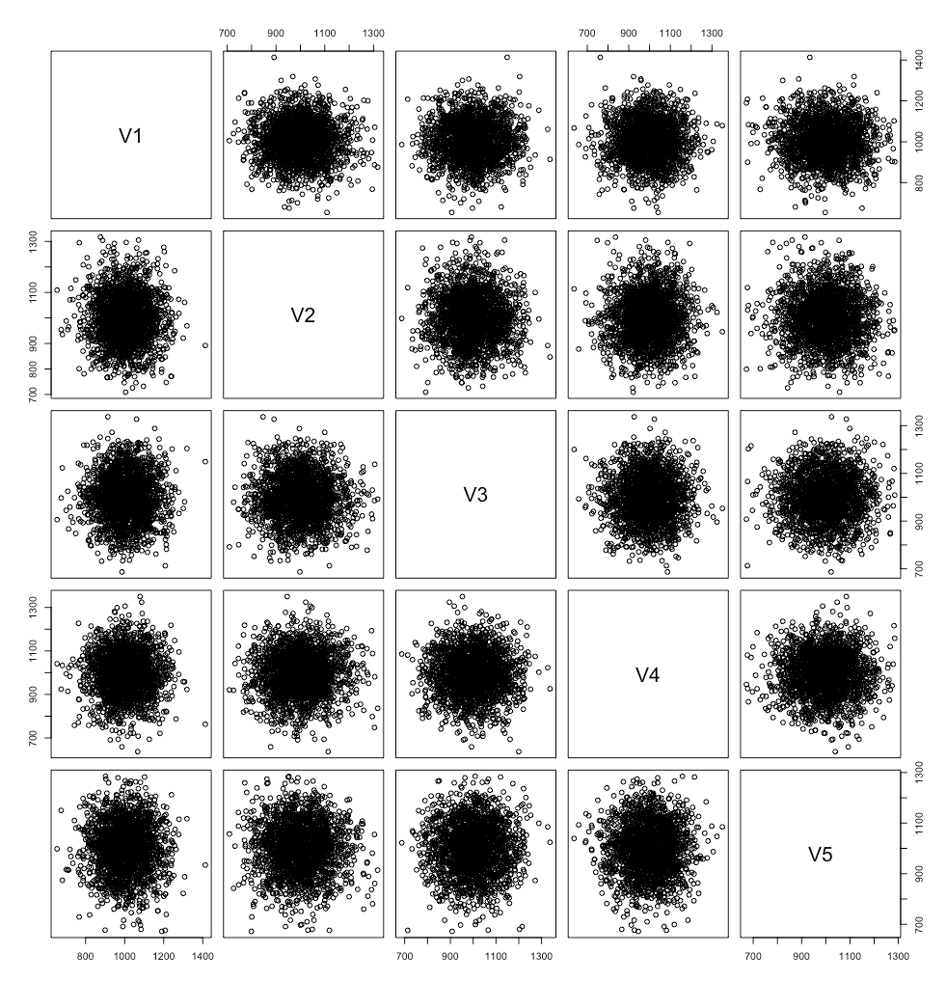
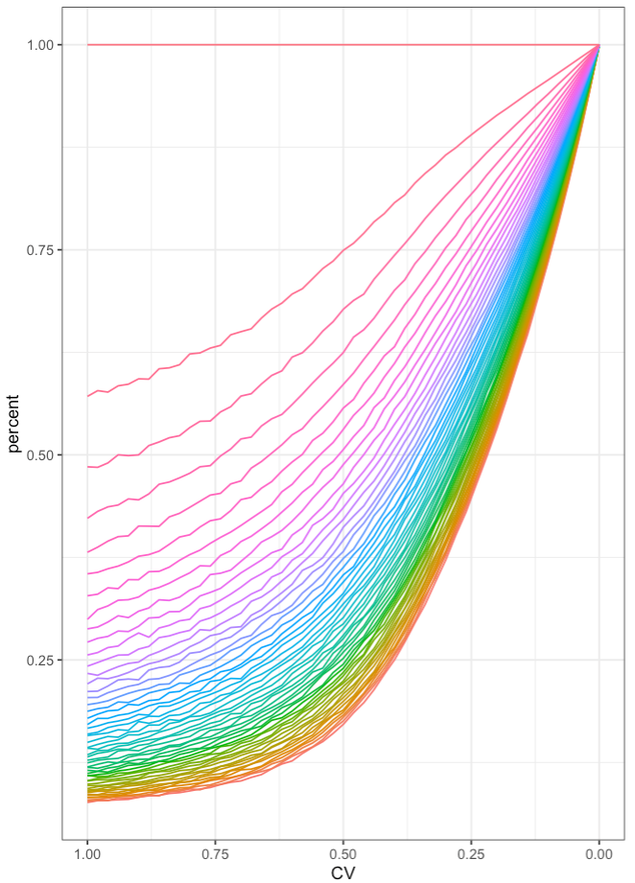
R = 0.8, mean = 1000, sd = 100
R = 0, mean = 1000, sd = 100
Toy heteromeric complex

Slide 4
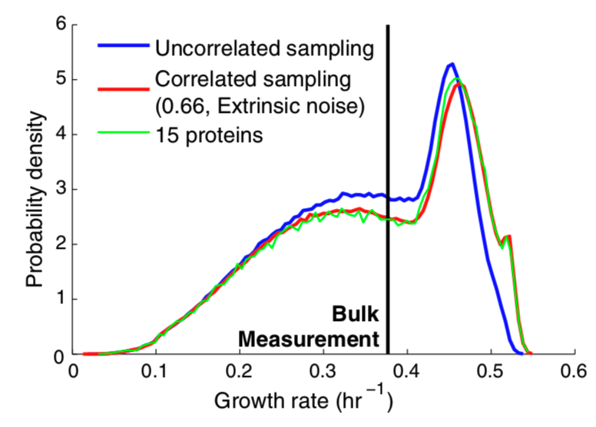
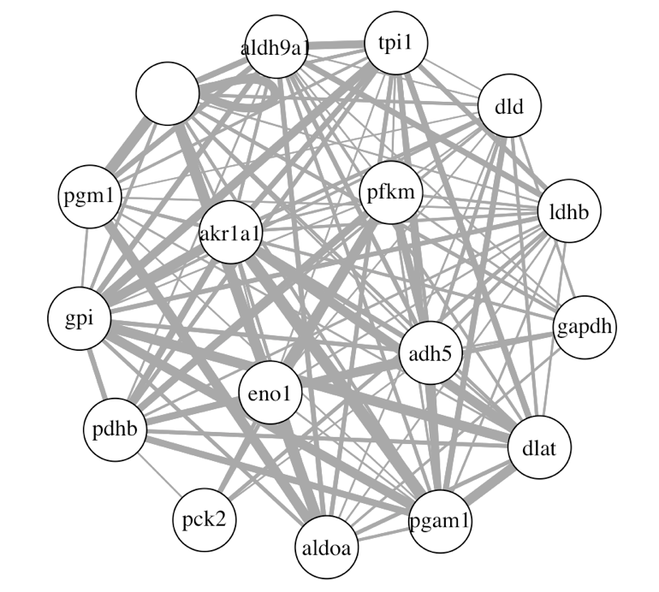
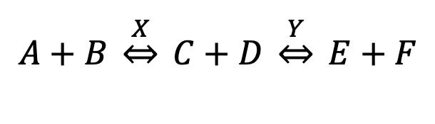
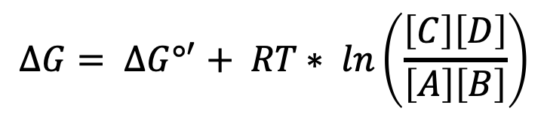
$$∆G= ∆G°^{′}+ RT∗ ln\left(\frac{\left[C\right]\left[D\right]}{\left[A\right]\left[B\right]}\right)$$
$$A+B \underset{⇔}{X} C+D \underset{⇔}{Y} E+F$$
Balanced
Unbalanced
X
Y
X
Y
Fwd Rxn Favored
Rev Rxn Favored

